Slide 1
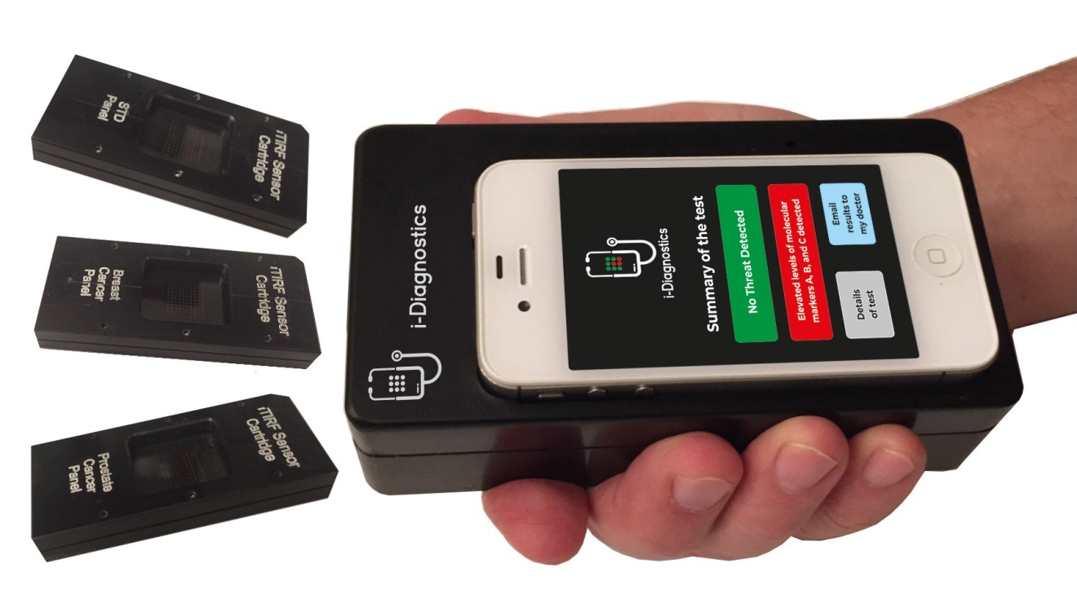
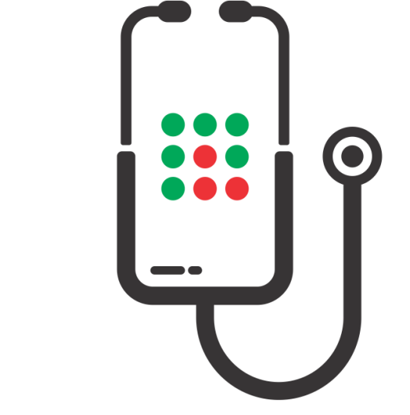
i-Diagnostics
The Handheld Future of Precision Medicine for Home-Use
Non-profit project to prevent future epidemics and minimize the damage from existing diseases. To be a step ahead of any disease
Dr. Alexander Asanov, CEO, TIRF Labs
i-diagnostics@TIRF-Labs.com
www.i-Diagnostics.net

Slide 2
Global Infrastructure for Biological Safety
Is Necessary to Prevent Pandemics
Rapid Precision Diagnostics and Proactive Intelligence Are Front Lines of Biological Safety
COVID-19 has demonstrated the necessity of infrastructure to prevent and localize outbreaks of infections. In 2008-2016, expert scientists foresaw the pandemics and stimulated the US government to create an infrastructure with proactive intelligence and advanced diagnostics as its frontlines [see 2016 PCAST letter to US President, Ref. 1]. However, the government disregarded this necessity. In 2020, Bill Gates, who invested millions of dollars in diagnostics, stated that “… most COVID-19 tests in the US are 'completely garbage' because it takes too long to get results” [1, 2]. We need global infrastructure for biological safety based on an open source diagnostics platform available to all research groups worldwide, as well as precision tests for home-use available to everyone .
TIRF Labs team pledges to make the i-Diagnostics platform available to all research groups, and the handheld, fast, accurate, home-use tests available for all. We envision that the i-Diagnostics non-profit project will prevent future epidemics and minimize the damage from existing diseases. We are uniquely positioned in the area and our way to give back to society is to create such open source platform for a global infrastructure of precision medicine, home-use diagnostics, single molecule biology, and for rapid drug screening.
www.i-Diagnostics.net

Slide 3



Natural and Artificial Pandemics
Biotechnologies enable great benefits to society, but come with the of self-eradication of humanity. Bioprinting and production of biotech products will be soon available to millions. A. Turchin et al. (2018) published a paper entitled “Artificial Multipandemic as the Most Plausible and Dangerous Global Catastrophic Risk Connected with Bioweapons and Synthetic Biology.” (ref. [3] slide 15). The study suggests that biohackers are the most likely source of pathogens capable of global biological catastrophe.
In recent years, naturally occurring infections have become far more resilient to treatment as they develop resistance to standard antibiotics. Prevention of natural and man-made pandemics requires proactive steps that include early diagnosing to localize the outbreaks. However, currently diagnostic tests are too slow and too inaccurate. By the time the lab results are ready, the disease could have spread to thousands of others. i-Diagnostics – precision tests for home-use will solve these problems.
Problems with the Current Diagnostics
Tests are expensive
In 2020 PCR tests for COVID-19 cost $1,800.
Tests are slow
In the US, average turnaround time is 1-3 days.
Tests are inaccurate
Too high rate of false negative and false positive results.
www.i-Diagnostics.net

Slide 4
i-Diagnostics – Critically Necessary Safety Net for Humanity
Revolutionary New Approach for Biological Safety
TIRF Labs, was founded by an internationally recognized expert in biodefense technologies, Dr. Alexander Asanov. He invented the platform technology, i-Diagnostics, which is uniquely well-suited for the envisioned biosafety infrastructure. In 1999-2018, Alexander served as the Principal Investigator on BAA and SBIR grants awarded by the US government totaling $4.3M. He assembled a team of scientists and engineers and developed advanced analytical instruments for Total Internal Reflection Fluorescence (TIRF) [www.tirf-labs.com]. TIRF Labs pioneered several ground breaking discoveries using the TIRF technique for life science applications. Over 200 research groups worldwide acquired TIRF products, generated unique research data and published articles in leading scientific journals.
We inquire your help for non-profit funding of our i-Diagnostics project, and for promoting the project to The Giving Pledge members or similarly situated philanthropists. This project does not pursue a for-profit objective. Our goal is to make precision tests affordable to everyone and the open source i-Diagnostics platform available to all research groups worldwide.
Along with the unique i-Diagnostics technology, the project offers revolutionary new approach of Open Source Platform, which will enable global fusion of the collective knowledge of diagnostic community. Global efforts on iDiagnostics project will lay the foundation for the necessary infrastructure and the network which will prevent emerging pandemics and minimize the damage form existing diseases via being a step ahead of any disease.
www.i-Diagnostics.net

Slide 5
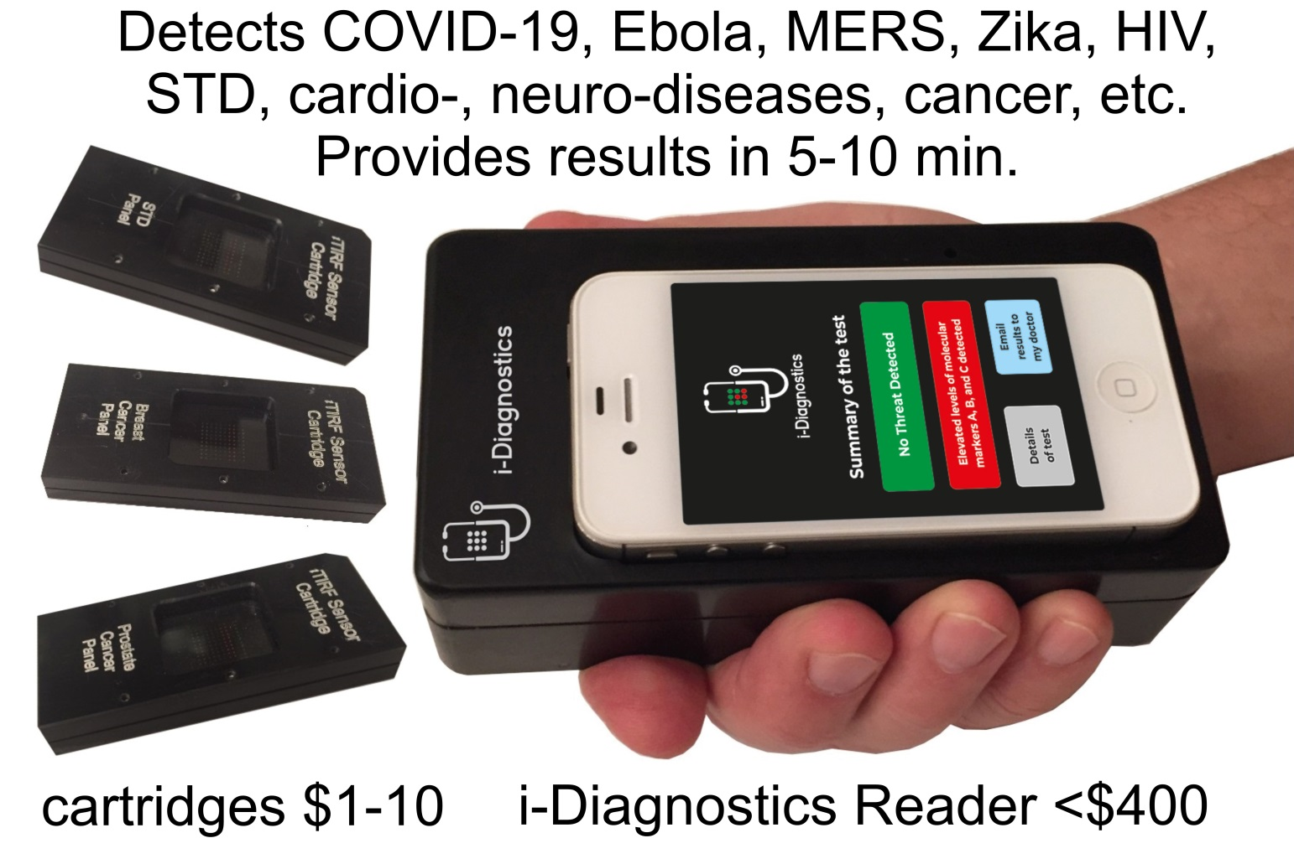

i-Diagnostics - Accurate and Rapid Tests for Home-use to Prevent Natural and Man-made Pandemics
Our goal is to make i-Diagnostics devices affordable to every family on the globe, and the open source i-Diagnostics platform – to all research groups worldwide. Accurate, rapid, personalized, yet affordable diagnostics for home-use will improve many aspects of healthcare and enable a multitude of related applications. i-Diagnostics unsurpassed accuracy comes from its ability to detect a panel of biomarkers of several classes simultaneously, including proteins, nucleic acids, and metabolites with ultimate sensitivity down to single molecules. i-Diagnostics® is robust, inexpensive (~$400/$1-10) and user-friendly for home-use, similar to the pregnancy strip test.
iDiagnostics® provides a unique solution that allows citizens worldwide to test themselves at home for pathogens and diseases.
Open-source i-Diagnostics platform allows for the rapid development of new testing kits in the event of novel, pathogen emergence.
www.i-Diagnostics.net

Slide 6
Powerful Combination of High Sensitivity, Accuracy, Speed, and Affordability
i-Diagnostics is a platform technology, where the information about new pathogen can be “dropped in” to start volume manufacturing of diagnostic tests in a matter of several hours.
Distinctive Features of i-Diagnostics Project
      Super-sensitive detection of proteins, DNA/RNA, metabolites, and selected chemical agents.
      Simultaneous multiplexed detection of up to thousands of molecular markers in a small sample of biological fluids, including saliva, sputum, urine, and whole blood.
      Many important biomarkers do not endure shipping and certain sample preparation procedures. i-Diagnostics® allows to perform analyses at the point-of-care.
      No or minimal sample preparation is necessary to perform the test.
      i-Diagnostics development tools are available to the entire diagnostic and R&D community.
      Open Innovation Business Model will involve up to 40,000 research groups.
      Several thousands of healthcare, agricultural, environmental, and other applications.
www.i-Diagnostics.net

Slide 7
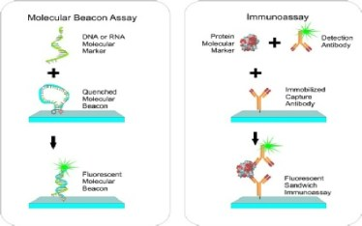
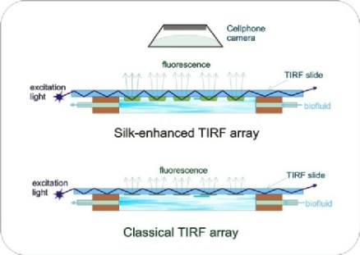
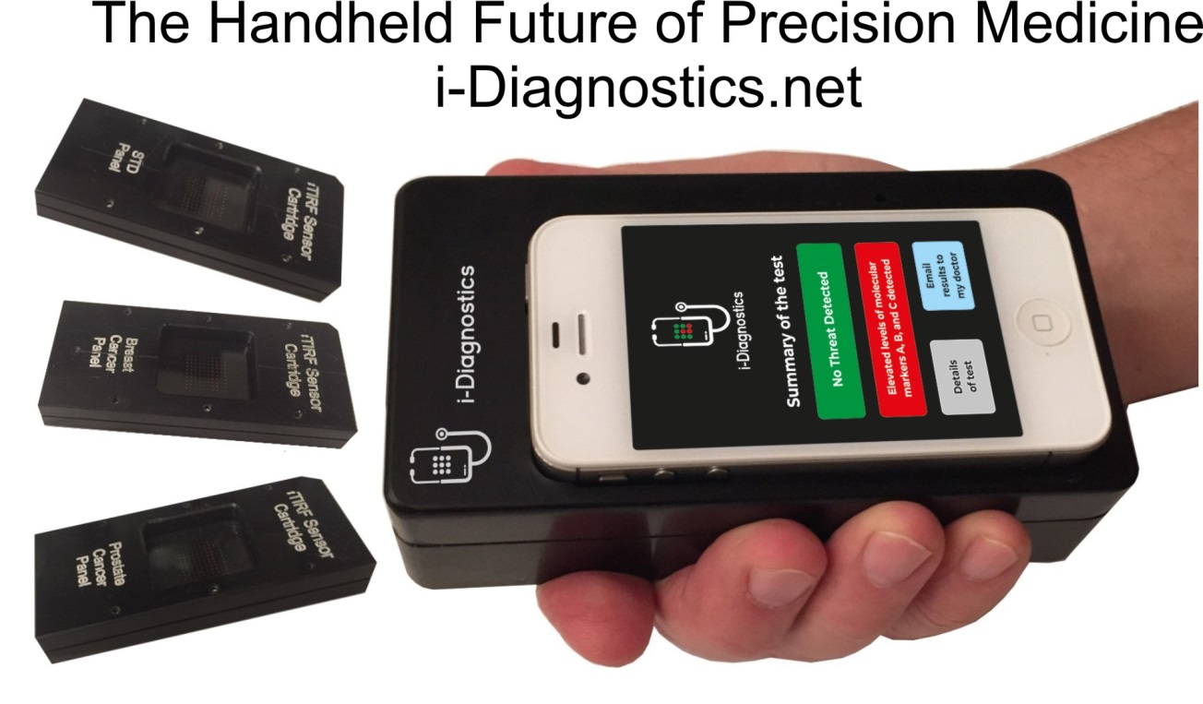
How i-Diagnostics Works?
The underlying technology of i-Diagnostics uses the principles of real-time TIRF microarrays to simultaneously detect four classes of molecular markers – DNA, RNA, proteins, and metabolites in bodily fluids such as saliva, urine, sweat, blood, and other fluids.
Preparation
A biological fluid, e.g. blood, urine, saliva flows over the microarray of bioassays. Each bioassay contains an affinity molecule, which specifically binds only the specific target biomarker, which results in de-quenching or emerging of fluorescence.
Detection
Excitation light propagates inside the TIRF slide reflecting from the top and the bottom. A microarray of bioassays is printed at the bottom surface. If a biomarker is present, respective spot of the microarrays fluoresces, and the emission is detected by low-light cellphone camera.
Analysis
The kinetics of fluorescence response is analyzed by i-Diagnostics app; concentrations of multiple bio-markers are derived; the data are combined with clinical symptoms entered into the app; and in 5-10 minutes after applying the sample, test results are reported.
Principles of i-Diagnostics are described at the URL http://www.i-diagnostics.net/tirf_technology.html
www.i-Diagnostics.net

Slide 8
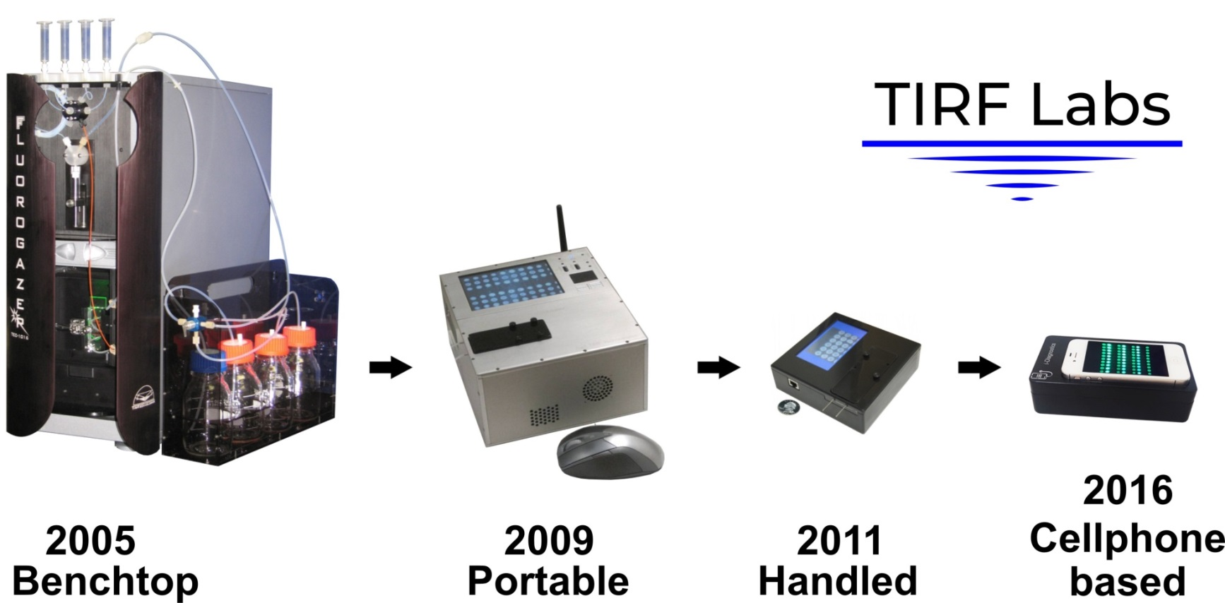
Why is i-Diagnostics so Uniquely Advantageous?
The answer lies in the phenomena of Total Internal Reflection and the Evanescent Wave, the main actors in real-time TIRF microarrays, the underlying technology of i-Diagnostics.
TIRF phenomena provides exceptional surface selectivity and enables the ultimate limit of detection - down to single molecules.
TIRF is capable of detecting a multitude of molecular markers of four classes simultaneously, a feature not found in any other technology.
TIRF microarrays require minimal to no-sample-preparation.
Results are obtained in a matter of 5-10 minutes.
This supersensitive, accurate and rapid technology, can be downsized to an inexpensive handheld device for home-use with disposable cartridges that cost $1-10.
We are not aware of other technology that is sensitive, accurate, and rapid, detects all four classes of biomarkers, and yet is affordable.
Our progress in TIRF microarray development spanned from large bench-top instrument through portable sensors to small handheld devices.
In 2013, we discovered that silk fibroin enhances the fluorescence of TIRF microarrays so that we can use a cellphone camera instead of expensive cameras. This patent-pending discovery has been incorporated into i-Diagnostics.
www.i-Diagnostics.net

Slide 9
i-Diagnostics Applications
Prevention of pandemics and epidemics
Diagnosing of infection diseases: SARS, influenza, Ebola, HIV, Zika, STDs, etc.
Diagnostics and prognosis of cancer
Diagnostics and prognosis of cardio-vascular diseases
Diagnostics and prognosis of Alzheimer's and other neurological disorders
Drug development studies
Longevity studies and popular efforts
Food and water safety applications
Military and civil biodefense applications
Forensic applications
Environmental applications
Agricultural analyses and studies
As soon as i-Diagnostics becomes popular, many routine analyses of blood, urine and other bodily fluids that currently are performed in clinical labs, will migrate to the i-Diagnostics device.
Along with the main goal of home-use, family doctors, cardiologists, dentists, first responders, pharmaceutical companies, food safety, agriculture, and environment protection specialists have expressed their interest in using i-Diagnostics for their applications.
There are thousands of new applications that can be developed for the i-Diagnostics platform.
www.i-Diagnostics.net

Slide 10
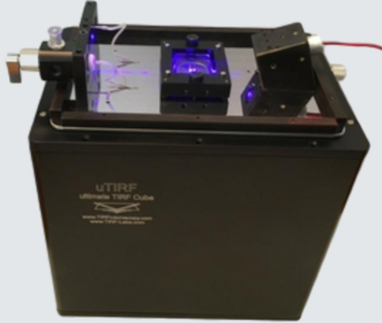
Open Source Platform Technology
Open Source Platform model will be used in this project to create global network of experts, which will enable the exchange of intellectual property between collaborators. TIRF Labs is already an integral part of the global diagnostic community. We have supplied our advanced TIRF instruments to over a hundred of research groups worldwide and have created the prototype of the network, which will lay the foundation for an extended biological safety network, which is of paramount importance for the envisioned infrastructure. TIRF Labs has already supplied our i-Diagnostics development tools to several research groups and received enthusiastic responses from them. We will supply to R&D community our patented technologies as open-source platform to facilitate the development of applications. Our unique hardware, software, cartridge blanks, development tools, reagent kits, methods and protocols will help to interface existing bioassays with the i-Diagnostics platform and develop new assays and tests.
LICENSE
RESEARCH
DEVELOP
i-Diagnostics® licenses TIRF patents and provides application development kits (ADK) to universities and industry researchers.
Researchers around the world design specific applications and tests to detect biomarkers they know best.
Using the input of experts around he globe we will expand the applications of our i-Diagnostics platform.
uTIRF station – one of the development tools
www.i-Diagnostics.net

Slide 11
Funding, Research Network Expansion, and R&D Goals
In 2014, the US DOD performed a comprehensive survey of molecular diagnostic methods and ranked high our earlier prototype of i-Diagnostics for both biological and chemical detection. To date, we believe i-Diagnostics holds a unique combination of features that keeps the technology unrivaled.
To make the i-Diagnostics an open-source platform, develop basic applications, refine the prototype for home-use, and lay the foundation for the biological safety network, TIRF Labs is seeking ~$2 million to start the Phase 2.
This is a non-profit project. We envision a large social impact of our endeavor and address our request to The Giving Pledge, other philanthropists, and the US government.
The mission of this project is to create a mega-diagnostic platform for biological safety infrastructure by making i-Diagnostics technology an open source platform and the handheld precision diagnostics available to everyone, which is necessary for preventing future pandemics.
The significance of this project goes far beyond the scope of medical diagnostics.
Together with the envisioned handheld device, we are offering to the research community the entire line of TIRF instruments, development tools, methods, protocols and suppliers that facilitate all stages of diagnostics development.
This project will create a network of experts, consolidate efforts of international teams of medical doctors, healthcare professionals, administrators, businessmen, and grassroots enthusiasts, creating the powerful infrastructure for biological safety.
www.i-Diagnostics.net

Slide 12
i-Diagnostics Business Plan Outline
12 months
24 months
36 months
48 months
Project launch
Manufacture Application Development Kit (ADK)
Design and prototype iDiagnostics reader and cartridge
Raise $2 million to start Phase 2 efforts
18-24 months
Distribute ADK tools
License patents and facilitate IP exchange
Finalize design for iDiagnostics reader and cartridge
36 months
Integration of new arrays and diagnostics panels
Raise $64 million for manufacturing and integration
48 months
Large-scale manufacturing and distribution of iDiagnostics reader and cartridges for 12-20 applications including SARS, other infectious diseases.
Panel of ~30-40 assays for personalized treatment of infectious diseases
Deliverables 18-24 months: TIRF Labs will refine the development and supply the uTIRF station and i-Diagnostics Application Development Kit (ADK), supplies, manuals, protocols, reagent kits, cartridge blanks, sample prep modules to other research groups that are developing molecular diagnostic applications. The ADK and uTIRF will facilitate assay development, creating panels of biomarkers, and pre-clinical testing.
Deliverables 48 months: TIRF Labs will start manufacturing hand-held i-Diagnostics devices and begin supplying them to all interested parties, including general public.
www.i-Diagnostics.net

Slide 13
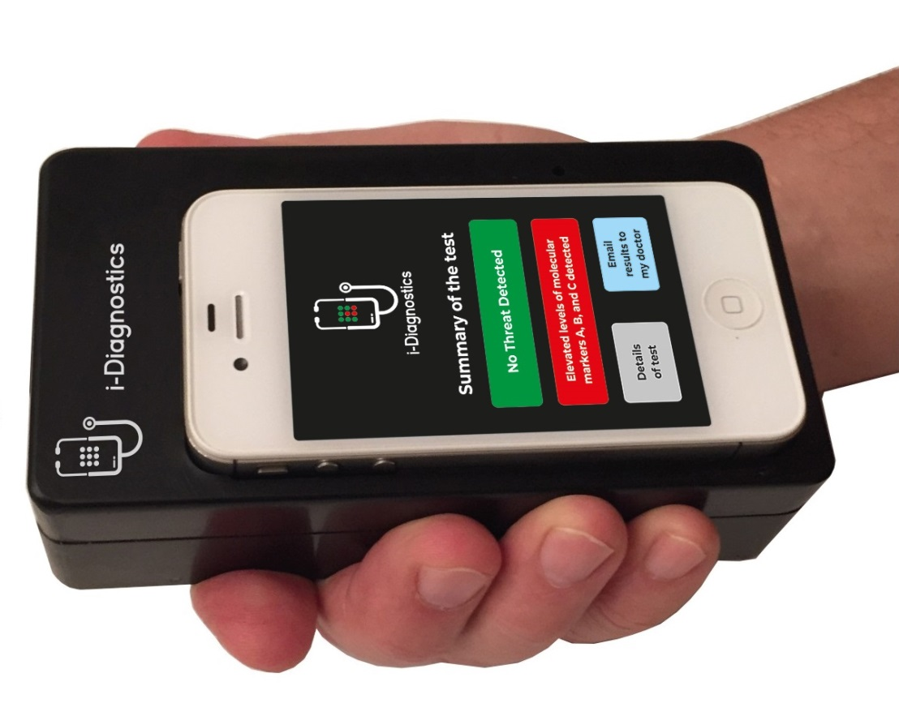
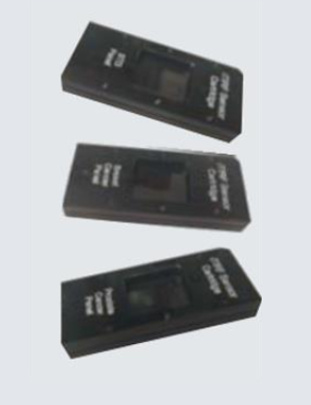
Deliverables
Home Use
Laboratory Use
iDiagnostics® Reader
uTIRF station – one of the development tools
Other application development tools
Disposable microarray cartridges
www.i-Diagnostics.net

Slide 14
TIRF Labs’ Team and Principal Investigator
TIRF Labs’ team is described at URL: www.i-diagnostics.net/about.html.
The Principal Investigator, Dr. Alexander Asanov, held academic positions at the Institute of Chemical Physics, Russian Academy of Sciences (RAS), the University of Alabama at Birmingham, and Mississippi State University. He received an M.S. degree in Biophysics from the Moscow Institute for Physics and Technology, and a Ph.D. degree in Chemical Physics from the Institute of Chemical Physics, RAS. His Ph.D. advisor was a Nobel Prize laureate N. N. Semenov; three other Nobel Prize winners, P. L. Kapitsa, A.D. Sakharov, and V. L. Ginzburg trained Dr. Asanov in several other areas of science.
Dr. Asanov has a broad background in spectroscopy, electrochemistry, molecular biology, cell biology, nanoengineering, chemistry and optics, which represent the key areas for the i-Diagnostics project. He has led successful R&D projects in the field of molecular diagnostics. The outcomes of the projects significantly exceeded expectations of the awards. Rather than demonstrating prototypes, Dr. Asanov in addition to prototypes arranged manufacturing and established sales of 3 lines of TIRF products: TIRF turnkey instruments, and TIRF accessories for microscopy and spectroscopy. Dr. Asanov believes he is well-suited to lead the proposed project. He pledged to give back to society his greatest assets: unique knowledge and skills, and believes that this non-profit project is the way of demonstrating his gratitude to America and to the world.
PUBLICATIONS AND AWARDS
50+ articles published in scientific journals.
$4M+ US government awards in BAA and SBIR grants.
RESEARCH AREAS
TIRF Spectroscopy, TIRF Microscopy, Electrochemistry, Molecular Engineering, Nanotechnology, Optical Engineering.
Dr. Asanov’s scientific biosketch URL: www.i-diagnostics.net/Biosketch_Alexander_Asanov2020.pdf
www.i-Diagnostics.net

Slide 15

FDA Compliance, Literature, Contact Us
TIRF Labs complies with all FDA guidelines for medical device manufacturers.
We adhere to the following FDA guidance:
Medical Device Software Guidance and Requirements.
Design Considerations for Devices Intended for Home-Use.
Guidance for Molecular Diagnostic Instruments with Combined Diagnostic and Research Functions.
  LITERATURE:
  Wired, Science, Bill Gates on COVID: Most US Tests Are ‘Completely Garbage’, Retrieved 2020, August, from https://www.wired.com/story/bill-gates-on-covid-most-us-tests-are-completely-garbage/
  Business Insider, Bill Gates says most COVID-19 tests in the US are 'completely garbage' because it takes too long to get results, Retrieved 2020, August, from https://www.businessinsider.com/bill-gates-covid-tests-us-completely-garbage-2020-8
  Turchin A., Green B.P., Denkenberger D., “Artificial Multipandemic as the Most Plausible and Dangerous Global Catastrophic Risk Connected with Bioweapons and Synthetic Biology”, Foundation for Longer Life, Moscow, Global Catastrophic Risk Institute, Tennessee State University, Santa Clara University, 2018, Retrieved 2020, August, from https://philpapers.org/rec/TURAMA-3
CONTACT US:
TIRF Labs, Inc., NC RTP, 106 Grendon Pl, Cary, North Carolina 27519, USA
Tel: 919.463.9545 info@tirf-labs.com
www.i-Diagnostics.net www.tirf-labs.com
©2023 TIRF Labs
www.i-Diagnostics.net

